Slide 1
Teradata Challenge 2019
Donor Analytics
Team 6
Hamsa Rajasekhara
Jacqueline Venigalla
Lakshmi Lavanya Nakka
Pragna Yelamanchili
Tejaswini Naredla

Slide 2
Contents
Introduction
Context
Background
Business Problem
Data
Survival Analysis
Modeling
Results
Future scope/Implications

Slide 3

Introduction
The 2019 Teradata Challenge asks for analyses on HHUSA’s data from various points of view to address the business problems faced by them
HHUSA is a non-profit organization. It aims to facilitate the success of veterans and military families in their civilian careers
Services of HHUSA’s include:
Creating a tailored civilian resumes
Translating military experience into civilian terminology
Teaching effective job search strategies, networking, and interviewing techniques and
Getting connected with companies who want to hire veterans and military spouses
.

Slide 4
Context
For our project, we chose the “Development” domain, which includes a series of questions that relate to donations, and the behavior and characteristics of donors
Every dollar donated to Hire Heroes’ mission helps transform the lives of military members, veterans, and military spouses as they transition into new careers
HHUSA is funded by various sources, including corporate and government grants, as well as events. But they must find a way to increase donations from individual and corporate donors

Slide 5
Background/Previous Research
Past analyses on donations and donor characteristics/behavior have included:
Logistic Regression: Most popular method, which predicts the likelihood that a donor will donate
Clustering: Which segments donors into groups that are as homogenous as possible. Strategies are then created to target certain segments
Donor Lifetime Value: Which is similar to Customer Lifetime Value

Slide 6
HHUSA’s Business Problem
HHUSA : Non-profit organization relies 100 percent on donations from different sources.
Problem: Donor retention
Goal : Increase donations to better serve veterans ,military members
Business Questions:
What is the average donor lifespan? - Donor lifetime value
Where are individual donors located? - Geographic area focus
Which state has the maximum number of donors?-Demographics of location

Slide 7
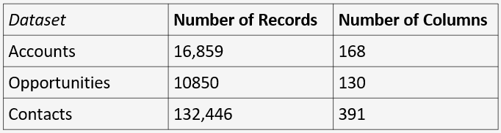
Initial Data
Many structured datasets were provided by Hire Heroes USA via Teradata
Combed through datasets to locate data relevant to donors, donor characteristics, and donor behavior
Determined 3 datasets to be particularly relevant
Snapshot of Initial datasets:

Slide 8
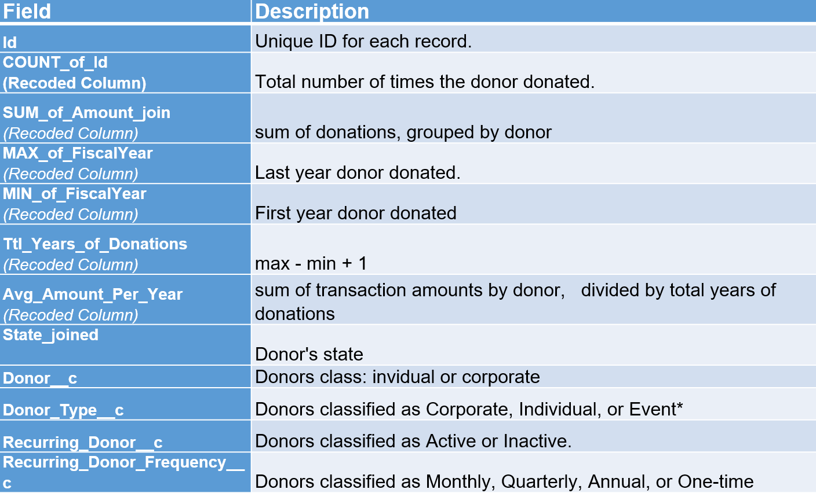
Data Descriptions

Slide 9
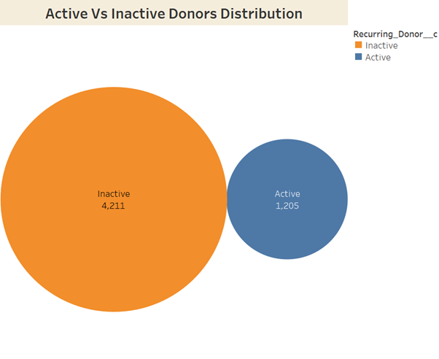
Donor classification
General Business Goal - Average donor lifespan
Donor lifetime value
Retain or Increase donations from current donors and attract new potential donors

Slide 10
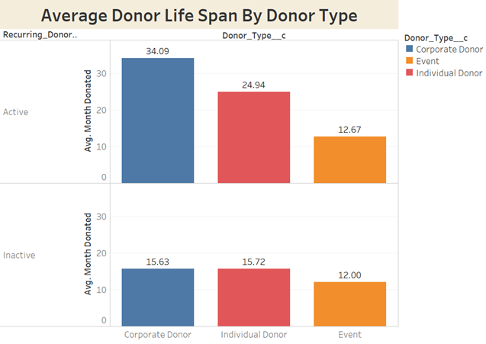
Average Donor Lifespan
State the results of those questions. Can provide charts or graph to summarize.
Average Donor Lifespan by Donor_Type_c
Both Active and Inactive donors (Recurring_Donor_c)
Corporate Donors most active and highest average months donated

Slide 11
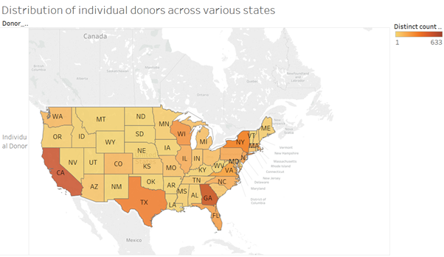
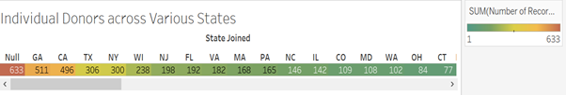
Geographical Concentration of Donors
State the results of those questions. Can provide charts or graph to summarize.
Geographical trends related to needs for different services
Further analysis - (function of the area’s average income, average number of veterans, or average population. )
Individual Donors over various states of USA.
GA :496 donors
Tx : 306 donors

Slide 12
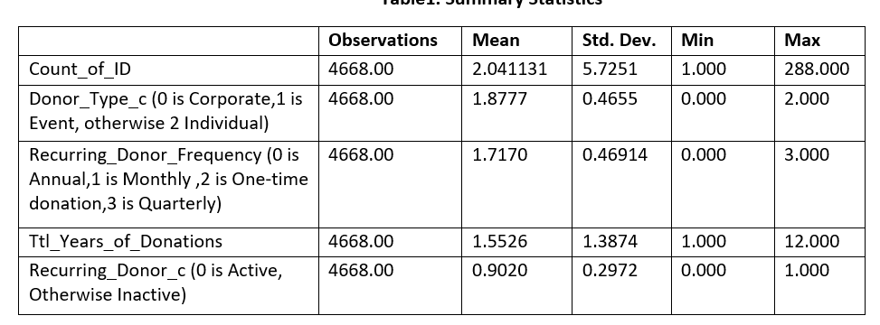
Final Dataset Statistics
4668*12 Records

Slide 13
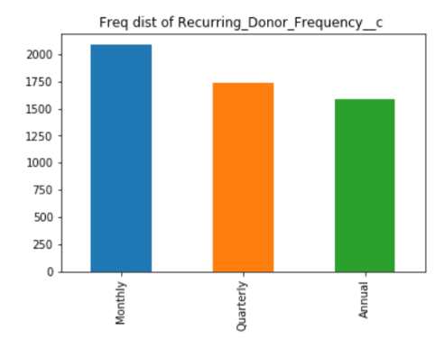
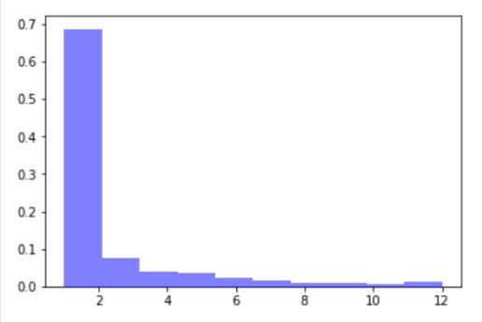
Final Dataset Statistics - Univariate Analysis
Years
Frequency distribution of variable Ttl_Years_of_Donations

Slide 14
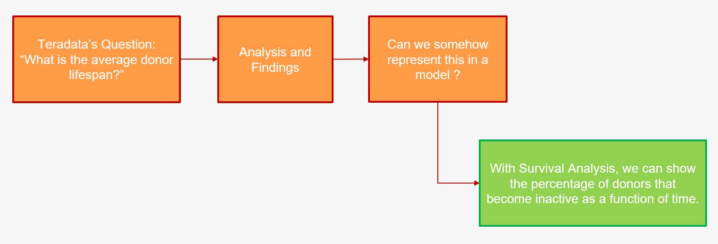
Further Analysis

Slide 15
Survival Analysis
Statistical Technique for analyzing the Time to Event based data
Considers that survival times are positive time and observations are censored
Censoring : Observations are censored when the information about survival time is incomplete
Survival Analysis methods include:
Parametric approaches such as Exponential, Weibull and lognormal distributions
Nonparametric approach such as Kaplan Meier
Semiparametric method called Cox proportional hazards regression model

Slide 16
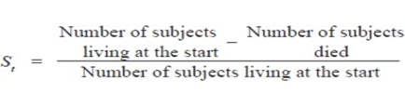
Modeling
Kaplan-Meier Technique estimates the probability of occurrence of event at regular time intervals
Kaplan-Meier survival curve plots the survival probability as a function of time
It provides descriptive statistics of survival information and draws the comparison of survivorship between two or more groups
To estimate the average lifespan of donors, we have dependent variables no of years of donations (time) and donor status (event)

Slide 17
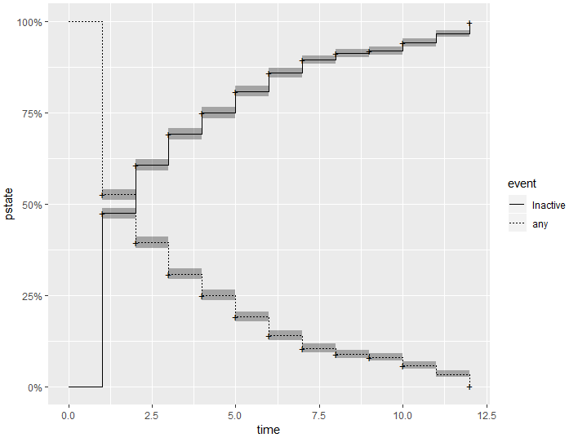
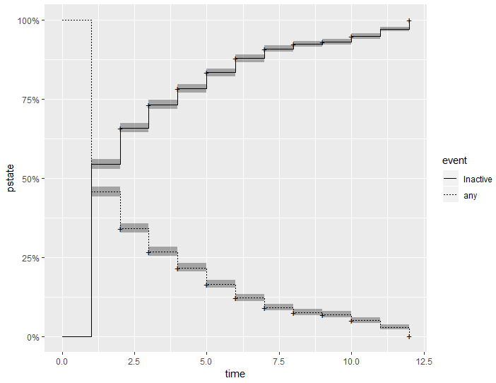
Results
Considering the years 2018 and 2019 we can infer that around 47.4% of the donors were inactive after their first year of donation
Without taking the donations that started in 2018 and 2019 into consideration we can see that around 54.4% of the donors become inactive after donating for a year

Slide 18
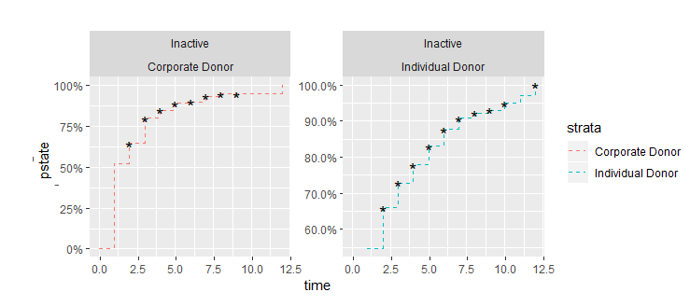
Results
Out of 211 Corporate donors 110 of them have become inactive after one year, which accounts to be 52.1%. Looking into the Individual Donors, out of 3634 donors, 1981 have become inactive after a year totaling the percentage up to 54.5%

Slide 19
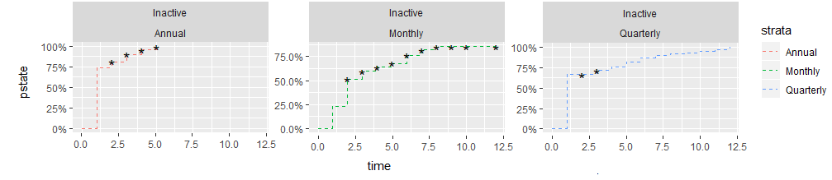
Results
Recurring Donor Frequency class we can clearly see from the below graph that 73.9% of the annual donors would go inactive after a year, 23.1% of Monthly donors and 66.2% of Quarterly donors go inactive after donating a year

Slide 20
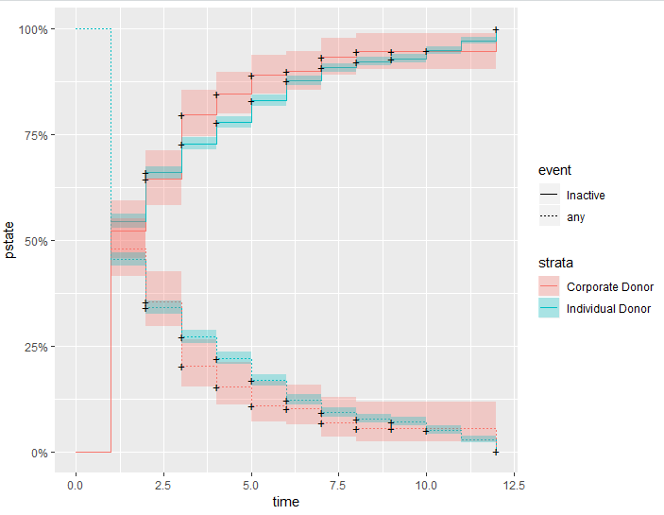
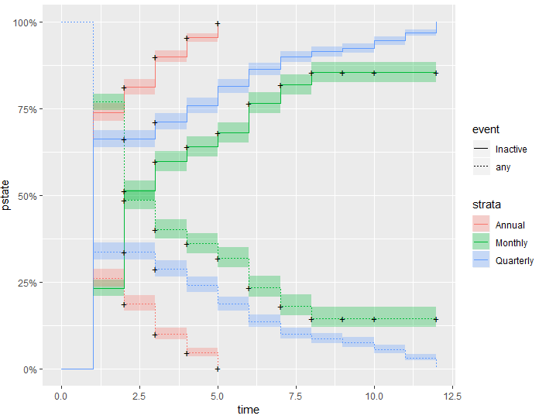
Implications
More than 50% of the donors become inactive after their one year of donation. And of the remaining donors who are active, the higher number of donations come from the Monthly donors

Slide 21
Next Steps for HHUSA
Use of Google Analytics
Improving relationships with the Donors
Fixed minimum amount of donations
More awareness of what HHUSA does

Slide 22
Thank You!
Questions?
Notes:
In Slide Show mode, select the arrows to visit links.

